Slide 1
7. Recurrent Neural Networks
Dr. John McCrae
Data Science Institute, University of Galway

Slide 2
Deep NLP

Slide 3
Machine Learning for NLP
We may wish to learn many things from text:
Sentiment Scores
Relations
Part-of-speech tags
Parse Trees

Slide 4
Machine Learning as a Black Box
Text
Output
x
y

Slide 5
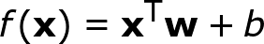
Linear models
For simplicity assume x is a vector and y is a value
The simplest model is linear
We could predict a boolean value by the sign of the output

Slide 6
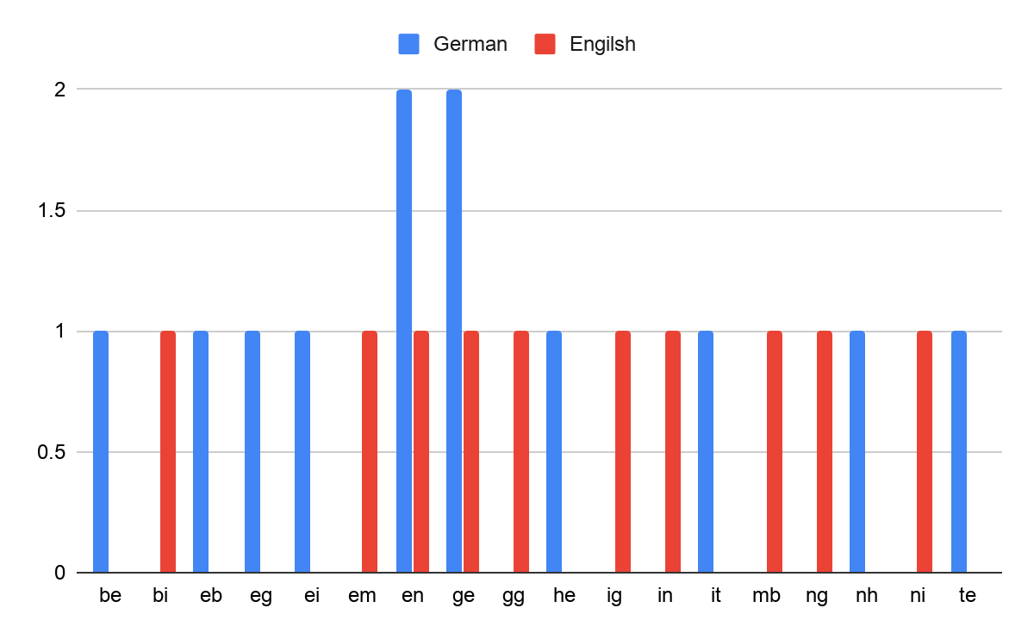
Example: language identification
Task: Given a word predict if it is English or German
Solution: Consider all character bigrams
“Gegebenheiten” => “ge”, “eg”, “be”...
“Embiggening” => “em”, “mb”, “bi”...

Slide 7
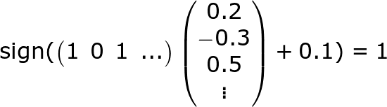
Example: language identification
“gegebenheiten” => (c(“be”), c(“bi”), c(“eb”)...) => (1 0 1 …)
How to find w and b?
Notes:
\text{sign}( \begin{pmatrix}
1 & 0 & 1 & \ldots
\end{pmatrix} \begin{pmatrix} 0.2 \\ -0.3 \\ 0.5 \\ \vdots \end{pmatrix} + 0.1) = 1

Slide 8
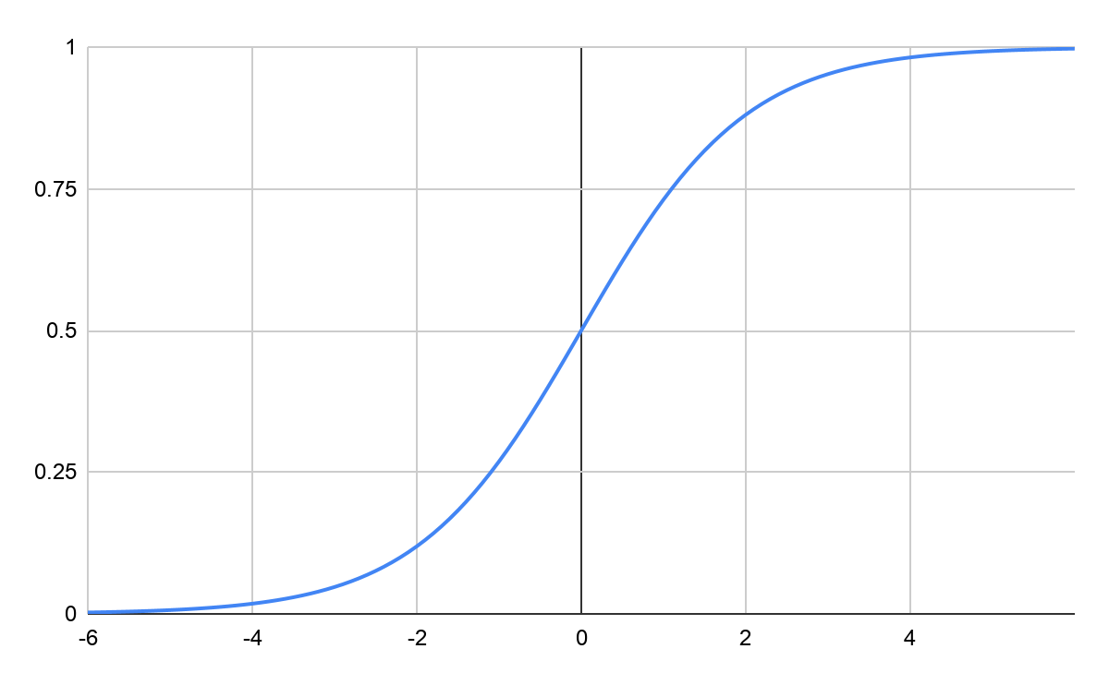
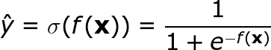
Log-linear modelling
f(x) as introduced outputs in range [-∞, ∞]
Instead we could use a function that outputs in [0, 1]
We can now say how certain we are of
a prediction
Notes:
\hat{y} = \sigma(f(\mathbf{x})) = \frac{1}{1 + e^{-f(\mathbf{x})}}

Slide 9
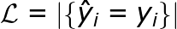
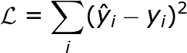
Training as Optimization
Assuming we have some known inputs x₁, … ,x_{n} and outputs y₁, …, y_{n}
We can learn by means of supervised learning
Loss Function: A function that measures how close our solution is
Absolute Precision
Euclidean Loss
Notes:
\mathcal{L} = -\sum_i\left[y_i\log(\hat{y}_i) + (1-y_i)\log(1-\hat{y}_i)\right]

Slide 10
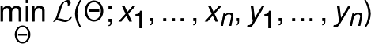
Training as Optimization
Denote all of our parameters as Θ = {w, b}
We aim to solve
This is rarely easy (or even possible) to do analytically.
Notes:
\max_\Theta \mathcal{L}(\Theta; x_1,\ldots,x_n,y_1,\ldots,y_n)

Slide 11
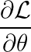

Gradient Descent
Tensorflow, Torch and similar calculate the derivatives and implement GD for you!
L
θ

Slide 12
Neural Networks as Ensembles
There are limits to what we can capture with (log-)linear models
Most NLP problems are very complex
Can we use multiple classifiers to solve complex problems?

Slide 13
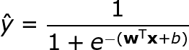
Log-linear model visualized
y
σ
…
x₁
x₂
x_{n}

Slide 14
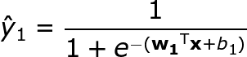


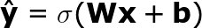
Multiple log-linear models
y₁
y₂
y₃
σ
σ
σ
…
x₁
x₂
x_{n}

Slide 15
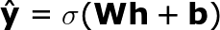
Multiple Layers
y₁
σ
σ
Note we now have the following parameters:
Θ = { W, V, b, c }
We can learn the model the same way.
σ
σ
σ
…
x₁
x₂
x_{n}

Slide 16
Recurrent Neural Networks

Slide 17


Input in NLP
In Computer Vision, images can be scaled to a fixed size.
In NLP, we can’t rescale a sentence:
Ti sa xml
This is an example

Slide 18
Parameter Sharing
Train same network for each word
h₁ = σ(Aw₁ + b)
h₂ = σ(Aw₂ + b)
….
h_{n} = σ(Aw_{n} + b)
Still a variable number of h_{i}
Share the same matrix for each word

Slide 19
Recurrent Neural Networks
...
...
Cell

Slide 20
Recurrent Neural Networks
Output layer is input of next cell
Parameters A and b are shared between each layer
A,b
Unroll
A,b
A,b
A,b

Slide 21


RNNs for NLP
We associate one word to each cell and (sometimes) an output
y₁
y₂
y₃
h₁
h₂
h₃
x₁
x₂
x₃
x is (often) a word embedding (see last week)
Notes:
\mathbf{s}_i = \sigma(\mathbf{U}\mathbf{s}_{i-1} + \mathbf{W}\mathbf{x}_i + \mathbf{v})
E = \sum_i E_i = \sum_i f(\mathbf{y}_i,\mathbf{y}'_i)

Slide 22
Applying RNNs
Tagging problems
Each individual cell output can predict a tag (e.g., part-of-speech, IOB named entity)
Sequence Classification (e.g., sentiment analysis)
Use initial and/or final state to predict state
Use average of outputs
Use weighted average: “attention models”

Slide 23
Tagging RNNs
Loss
For word-level tasks (e.g., part-of-speech tagging) we can predict on each cell
Output
Output
Output
y₁
y₂
y₃
h₁
h₂
h₃
x₁
x₂
x₃

Slide 24
Applying RNNs
Part of Speech Tagging
Language Modelling
NN
VBZ
DET
this
is
a
h₁
h₂
h₃
h₁
h₂
h₃
this
is
a
</s>
this
is

Slide 25
Predicting RNNs
Loss
For sentence level we can predict something based on the final state
Output Layer
discarded
discarded
h₁
h₂
h₃
x₁
x₂
x₃

Slide 26
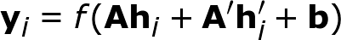
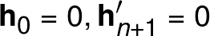
BiRNNs
Bidirectional RNNs combine two RNNs in both directions
y₁
y₂
y₃
h₁
h₂
h₃
h’₁
h’₂
h’₃
x₁
x₂
x₃
Notes:
\mathbf{h}'_i = f(\mathbf{U}'\mathbf{h}'_{i+1} + \mathbf{W}'\mathbf{x}_i + \mathbf{v}')

Slide 27

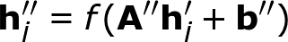
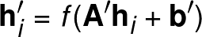
Stacked RNNs
y₁
y₂
h₁
h’₁
h’’₁
h₂
h’₂
h’’₂
x₁
x₂
Shared Parameters

Slide 28
RNNs as Language Models
Recall language models
Here we can use an Neural Network
x₂
x₃
</s>
s₁
s₂
s₃
x₁
x₂
x₃

Slide 29
Which model does this?
Looks at forwards and backwards context
Named Entity Recognition
BiRNN
Tagging RNN
Sentiment for a sentence
Complex, deep representation for each word
Predictor RNN
Stacking

Slide 30
Generation

Slide 31
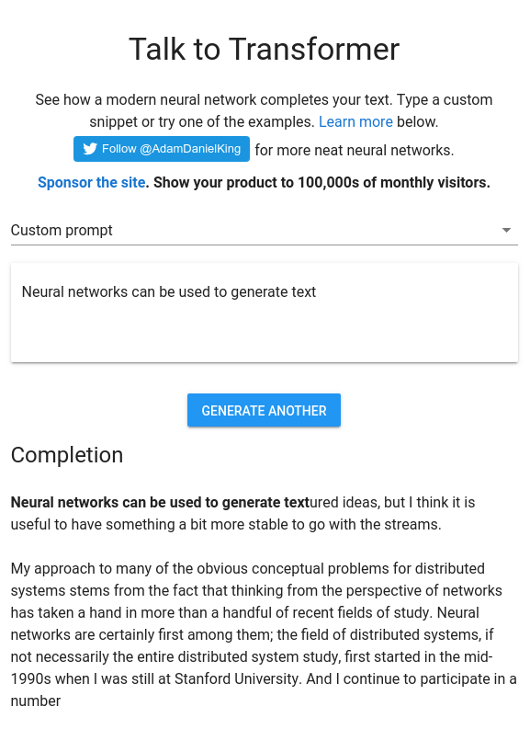
Training and Using Generators
Another application is to generate sequences
Generate a word from each cell
Use this as prediction to the next

Slide 32
Generator RNN
this
is
a
h₁
h₂
h₃
</s>
this
is

Slide 33
Conditioned Generation
We can guide the generation by adding some additional context (another vector)
this
is
a
h₁
h₂
h₃
</s>
Topic
this
Topic
is
Topic
Topic Embedding

Slide 34
Sequence to Sequence Models
We could even use another RNN to condition an RNN!
This is an example of a Sequence To Sequence (seq2seq)
Output
Output
Output
</s>
discarded
discarded
Input
Input
Input

Slide 35

Applications
Machine Translation
More later in the course!
Email Auto-response
Generation
Morphological analysis
Character RNN conditioned on the target, e.g., “play” + VBG => “playing”
Text summarization
p
l
a
y
i
n
g
VBG

Slide 36
LSTMs

Slide 37
Vanishing Gradient
Multiple layers act like lenses
The effect of far-away words is reduced
We call this ‘vanishing gradient’
It makes it hard to capture long-distance dependencies
TEXT

Slide 38
Gates
Gates allow us to control which information is passed through and which is not
TEXT

Slide 39
Gates
0.5
0.3
0.7
0.2
0.8
0.5
0.3
0.5
0.0
0.7
0.2
0.0
0.0
0.0
Filter
Some features of vector may not be relevant at this time
Hidden Layer Vector
Focus Vector

Slide 40
Gates
0.5
0.3
0.7
0.2
0.8
0.5
0.3
1.0
0.0
1.0
1.0
0.0
0.0
0.0
0.5
0.0
0.7
0.2
0.0
0.0
0.0
Hidden Layer Vector
Gate Vector
Focus Vector

Slide 41
Gates
Gate Vector
0.5
0.3
0.7
0.2
0.8
0.5
0.3
0.9
0.1
0.8
1.0
0.1
0.2
0.3
0.45
0.03
0.56
0.20
0.08
0.10
0.09
Hidden Layer Vector
Focus Vector
Another Neural Network

Slide 42
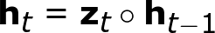
Gated Networks
h_{t-1}
✕
h_{t}
Sigmoids for gate
z_{t}
x_{t}
This (by itself) does nothing as h₀=0 and then never changes!
Notes:
\mathbf{h}_t = \mathbf{z}_t \circ \mathbf{h}_{t-1}

Slide 43
Long Short-Term Memory (LSTM)
Output gate on m selects relevance for next cell
h_{t-1}
✕
h_{t}
Two hidden states:
h: long-term
m: short-term
✕
m_{t-1}
✕
m_{t}
m is used as input to gates instead of h
c_{t}
x_{t-1}

Slide 44
Long Short-Term Memory (LSTM)
h_{t-1}
✕
h_{t}
m_{t-1}
Long-term path
x_{t-1}

Slide 45
Long Short-Term Memory (LSTM)
Short-term path
h_{t}
✕
m_{t-1}
✕
m_{t}
c_{t}
x_{t-1}

Slide 46

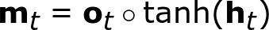
Long Short-Term Memory (LSTM)
h_{t-1}
✕
h_{t}
m_{t-1}
✕
m_{t}
✕
c_{t}
x_{t-1}
Notes:
\mathbf{h}_t = \mathbf{f}_t \circ \mathbf{h}_{t-1} + \mathbf{i}_t \circ \mathbf{c}_t
\mathbf{c}_t = \tanh(\mathbf{W}_c\mathbf{x}_t + \mathbf{U}_c\mathbf{m}_{t-1} + \mathbf{b}_c)

Slide 47
Summary

Slide 48
Summary
Deep learning is a general method for machine learning
Recurrent neural networks chain together networks for each word
Tagging and prediction can be done with RNNs
RNNs can be bidirectional and stacked
RNNs can generate text
LSTMs are a variant that avoids vanishing gradients

